Slide 1
Machine Translation models for Cantonese­-English pair
Liu Hey Wing

Slide 2


Outline
Introduction
Background
Previous studies
Aims and Objectives
Methodology
Data collection
Different MT models
Evaluation
Project status
Current progress
Results & discussions
Limitations & recommendations
Future planning
Conclusion

Slide 3
Introduction

Slide 4
Machine Translation (MT)
Developed since 1960s
Goal: translate natural human languages
Composition
Declarative information (data)
Procedural information (algorithm)
Limitations
Translational directions
Quantity of languages
Linguistic involvement

Slide 5
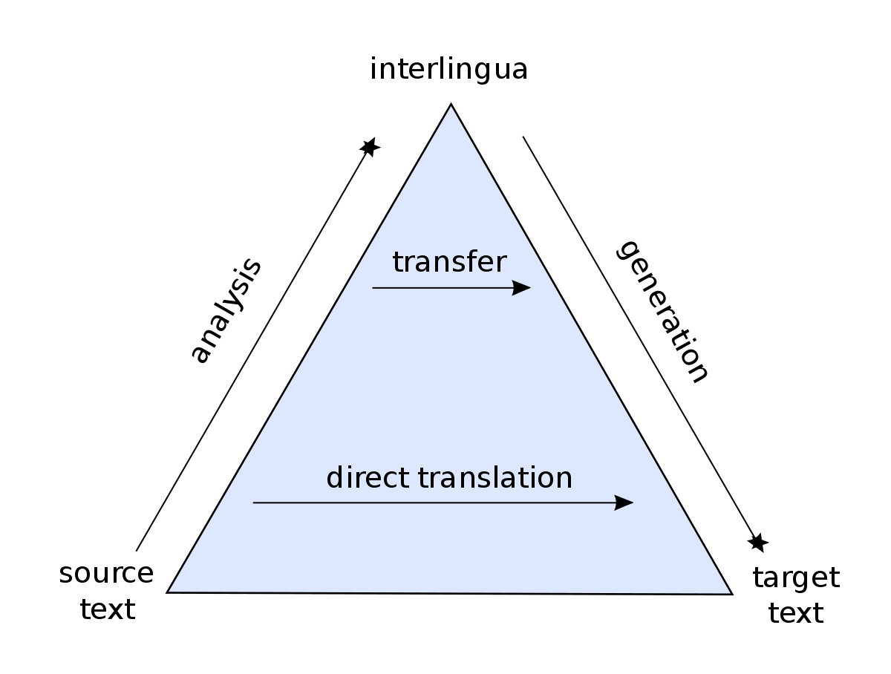
Linguistic aspect
Language status
Cantonese is the 18th largest language by user in the world [1]
Active research on Cantonese Linguistic
No standardized written form
No standardized romanization system
Figure 1: Bernard Vauquois' pyramid [2]

Slide 6
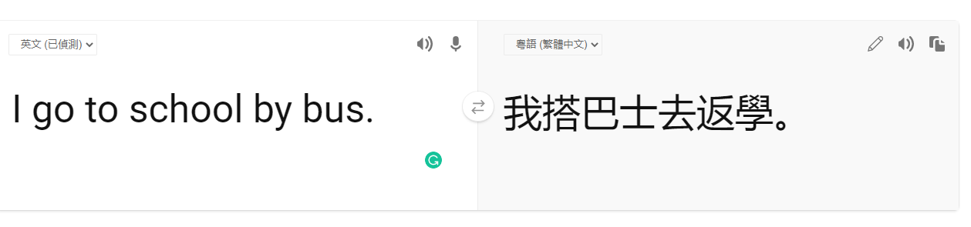
Computational aspect
Siri, Google Assistant supports Cantonese speech input
There are not many available resources about Cantonese translation
Only 2 available platform for Machine Translation, Microsoft & Baidu
Figure 2: Snapshot from Bing Microsoft Translator https://www.bing.com/translator

Slide 7
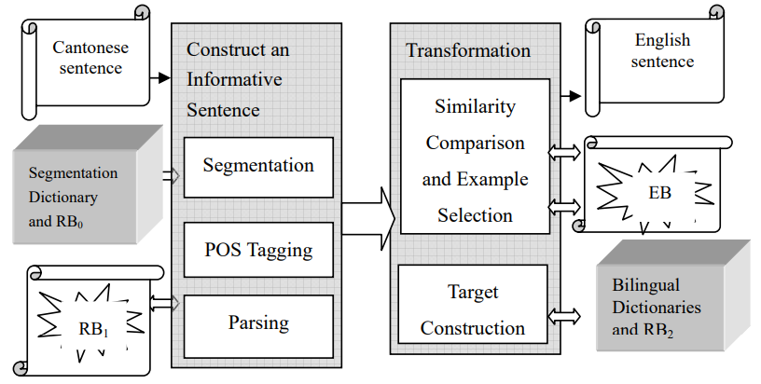
Previous Studies
PolyU­MT­99 [3]
The first MT system implemented for Cantonese ­English pair in 1999
LangCompMT05[4]
Based on PolyUMT99, combined EBMT & SMT, developed in 2005
Unreliable source
Used non-Cantonese Sentence
Figure 3: Structure of LangCompMT05 [4]

Slide 8
Objectives
Lack of research in Cantonese NLP and MT
Investigate reasons and obstacles
Outline future development of Cantonese-based MT

Slide 9
Scope and deliverable
Implement MT systems for Cantonese-English pair
Include historical models and cutting-edge technology
Discover the reasons for the absence of Cantonese MT

Slide 10
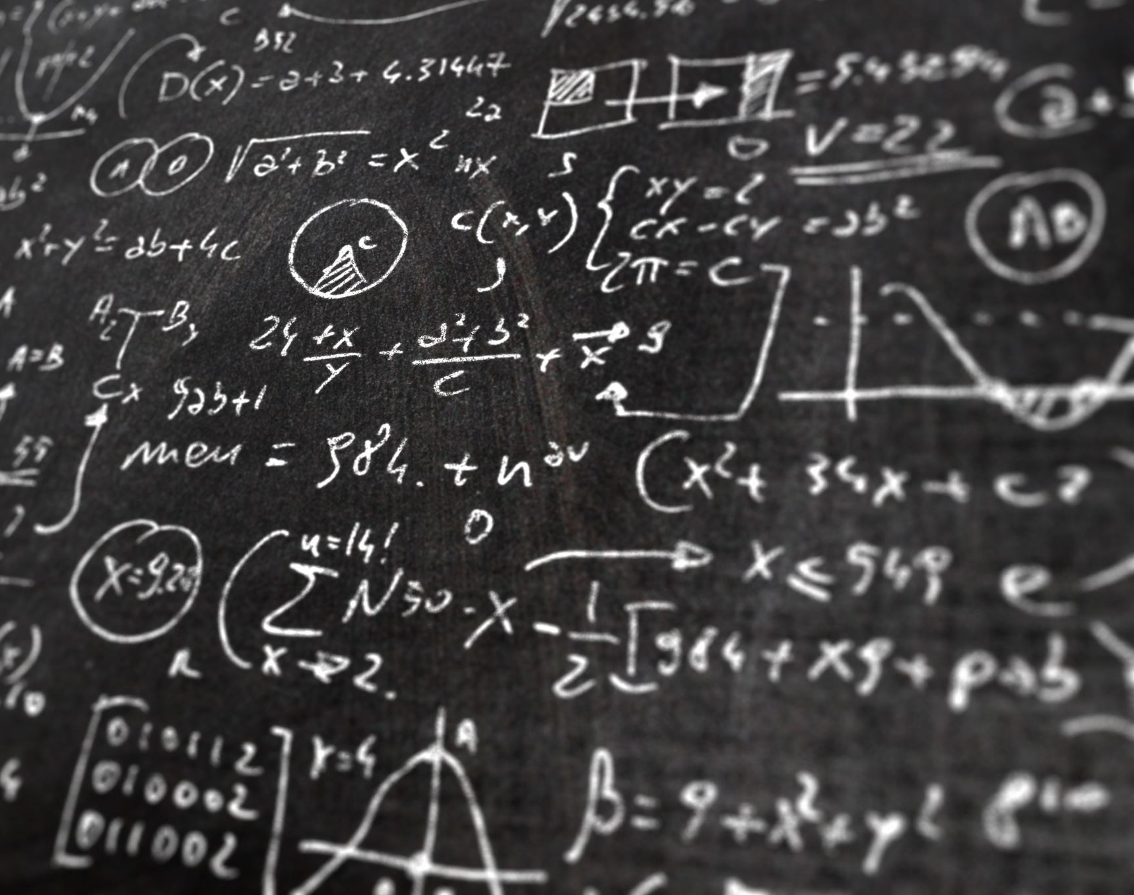
Methodology

Slide 11


Data Collection
No open-source corpus of bilingual materials
Bilingual corpus is essential
Only available in written Chinese
(different syntax and lexicon)
Ted Talks
Open-source for fan translation
Web scraping using Beautiful Soup [5]
Netflix subtitle
Cantonese Movies + English Subtitle
Google Speech-to-text API provided by pyTranscriber [6] for Cantonese transcription

Slide 12
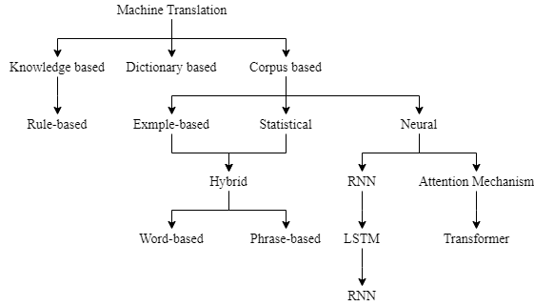
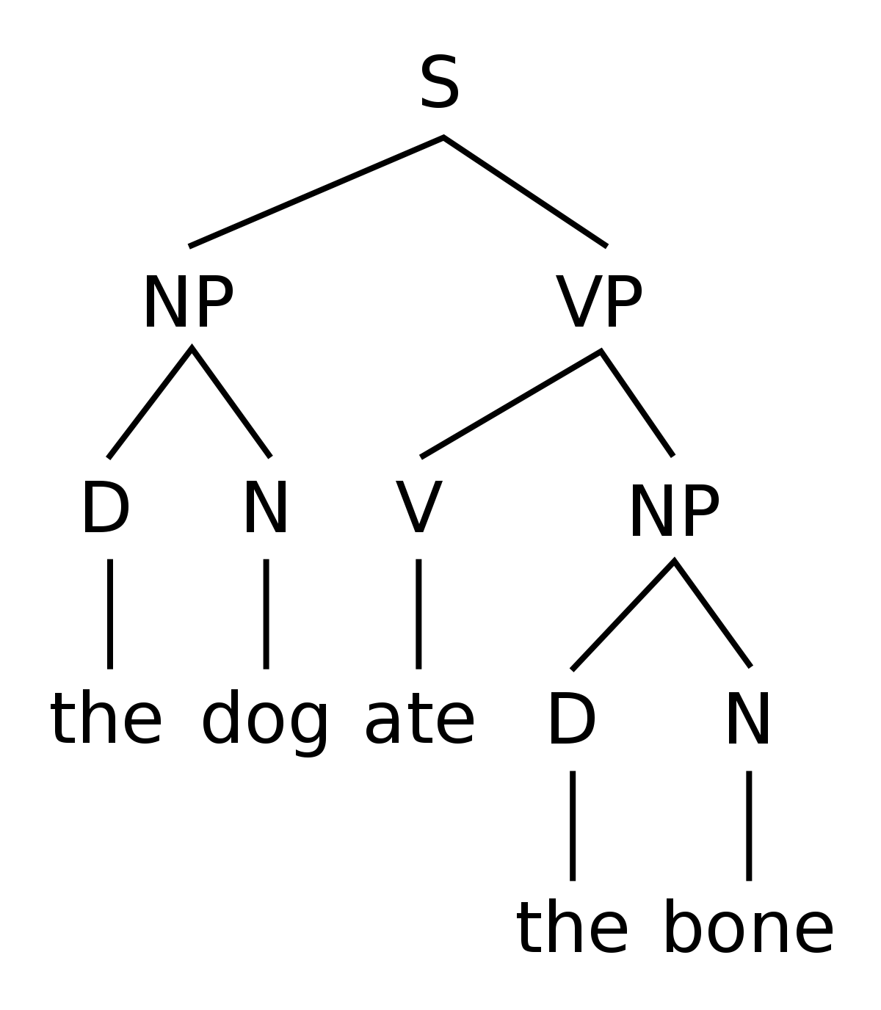
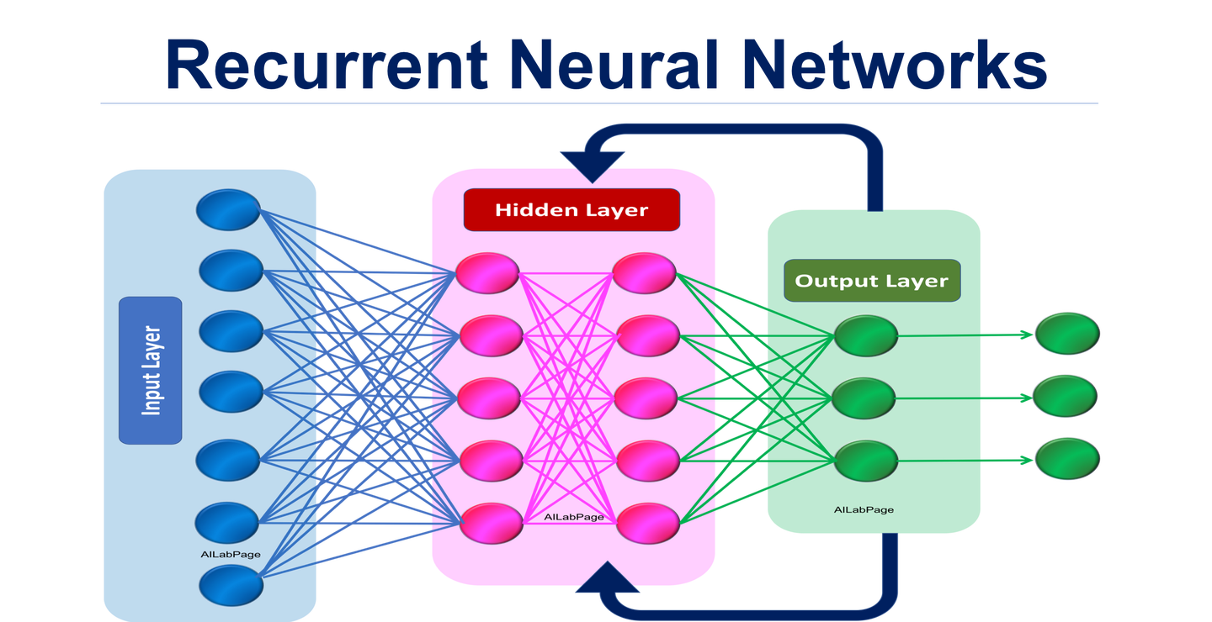
Examples of MT
Rule-based machine translation (RBMT)
Example-based machine translation (EBMT)
Statistical Machine Translation (SMT)
Word-based
Phrase-based
Neural machine translation (NMT)
Recurrent Neural Network
Attention Mechanism
Different MT systems has pros and cons
Different architecture

Slide 13
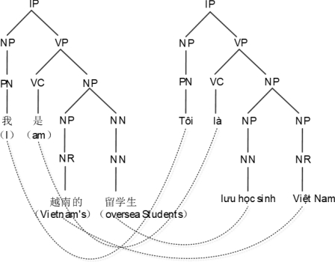

Rule-­based machine translation (RBMT)
Figure 4: example of tree-to-tree translation [8]
Structure of Apertium [5]
Popular in 1980s
Predominantly use linguistic knowledge, e.g., syntax, morphology
Decompose and reconstruct sentence
Framework: Apertium [7]

Slide 14

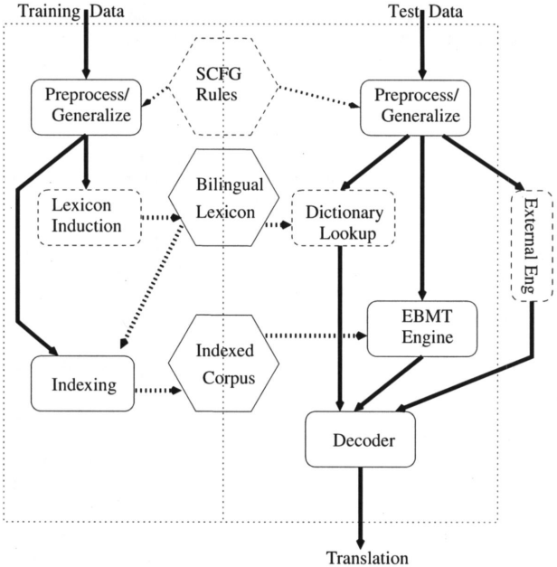
Example-based machine translation (EBMT)
Popular in 1990s
Replace instance by examples
Examples from [9] of English-Japanese MT
(1)(a) He buys a notebook.
Kare wa noto o kau.
(b) I read a book on international politics.
Watashi wa kokusai seiji nitsuite kakareta hon o yomu.
(2)(a) He buys a book on international politics.
(b) Kare wa kokusai seiji nitsuite kakareta hon o kau.
Framework: N/A
Figure 6: Structure of CMU-­EBMT [10].

Slide 15
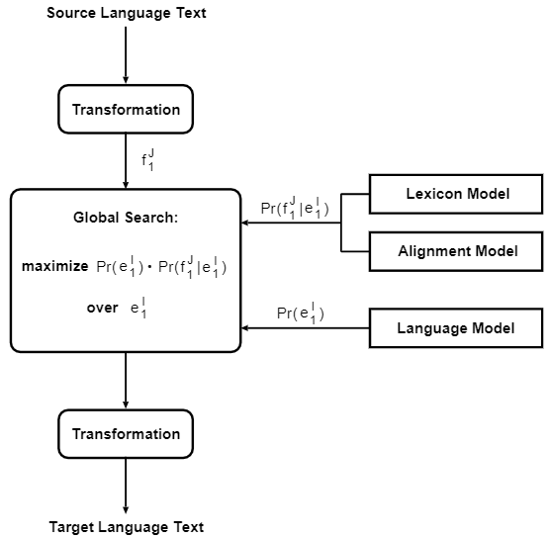
Phrase-based Statistical Machine Translation (PBSMT)
Popular since 1990s
Compute probability of output by Bayes Decision Rule
Old “State-of-art” in MT
Framework: Moses [11]
Figure 7: Structure of Bayes Decision Rule applying [12]

Slide 16
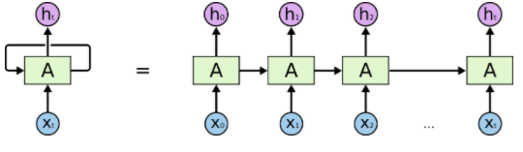
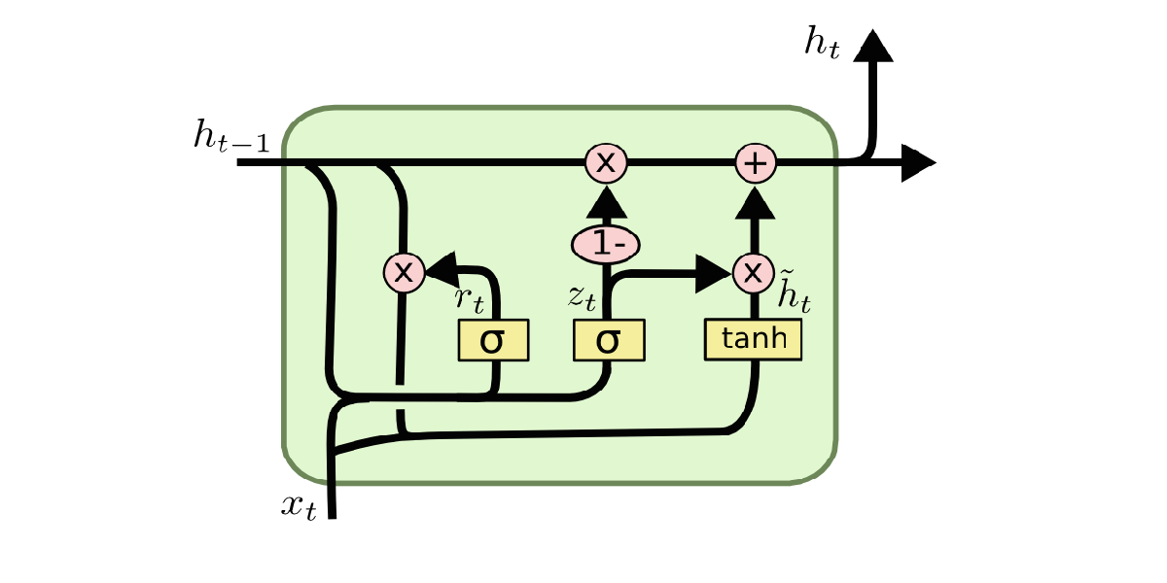
RNN -- GRU
NMT gained popularity since 2010s
Use Hidden Markov Models (HMM) and Artificial Neural Network (ANN)
Recurrent Neural Network (RNN) means that the result and input will pass on next stage
Gated Recurrent Unit (GRU) [13] is a variant of RNN cells perform long-term memory in fast speed
Framework: pyTorch provided by D2L [15]
Figure 8: RNN model [14]
Figure 9: GRU cell [14]

Slide 17
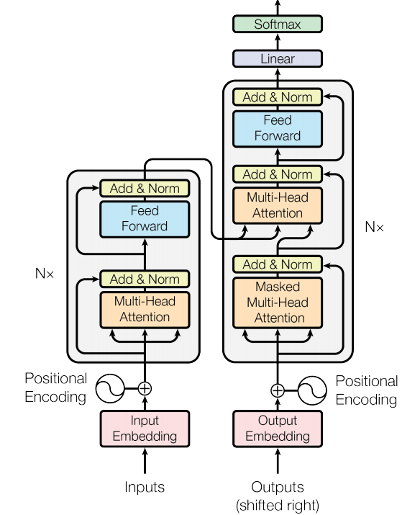
Transformer – Attention Mechanism
Developed in 2017 [16]
Use Multi-head attention mechanism to predict result
Avoid information loss and overfit in ANN
New “State-of-art” in MT
Framework: Tensorflow [17]
Figure 10: Structure of Transformer model [16]

Slide 18

Evaluation
Human evaluation is not preferred
Time & Cost
Reliability
Automatic evaluation, metrics [18]
E.g., BLEU, WER, NIST
Comparison of performance
Important training process for MT

Slide 19
Summary
Data:
Ted Talks
Netflix
MT models
RBMT: Apertium [6]
PBSMT: Moses [10]
RNN -- GRU: TensorFlow with GRU cell [12][14]
Transformer: TensorFlow with Transformer model [14][15]
Evaluation
Automated metrics, BLEU [16]

Slide 20

Project status

Slide 21
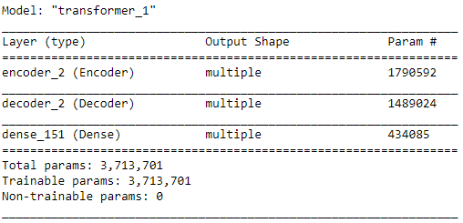
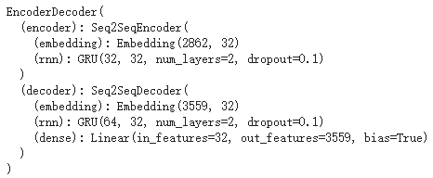
Current progress
Data collected
Parallel corpus of 9000+ sentences
Installed all 4 MT systems
2 models had completed pilot run
Keep on schedule
Figure 11: Example sentences from corpus
Figure 12: Structure summary of Transformer
Figure 13: Structure summary of RNN-GRU

Slide 22
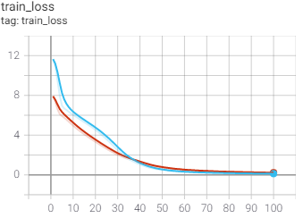
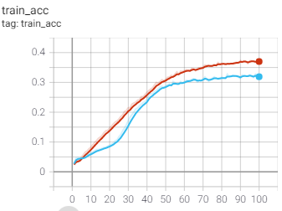
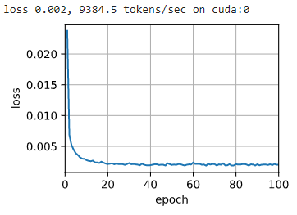
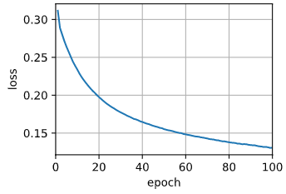
Result
Red = Char, Blue = Vocab
English to Cantonese
Vocab vs Char base
Transformer
num_layers = 4
d_model = 128
dff = 512
num_heads = 8
GRU
embed_size = 32
num_hiddens = 32
num_layers = 2
dropout = 0.1
Figure 14: Training accuracy & loss of vocabulary and character based Transformer
Char-based
Vocab-based
Figure 15: Training loss of vocabulary and character based RNN-GRU

Slide 23
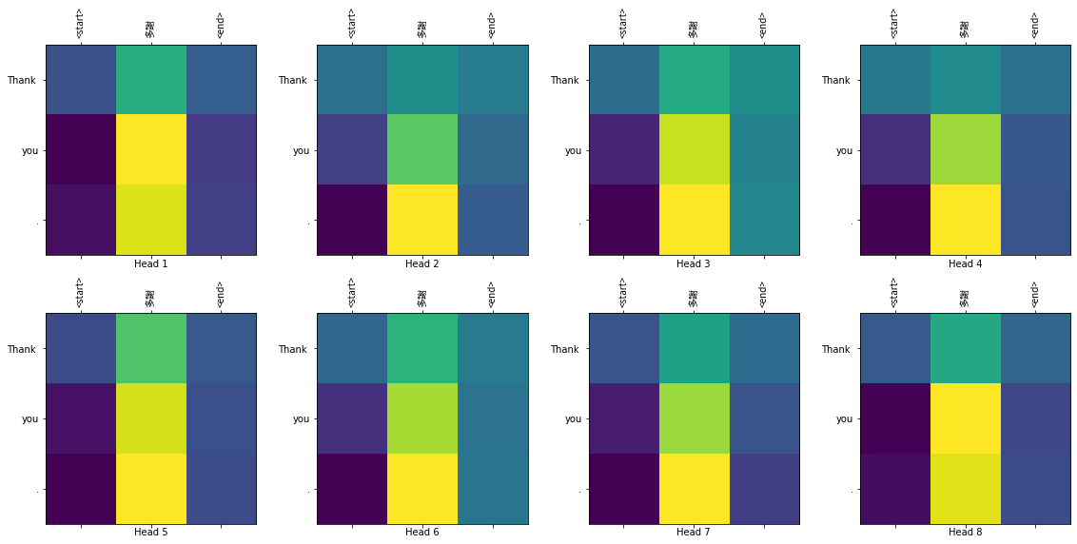
Figure 16: Example of attention mechanism in Transformer

Slide 24
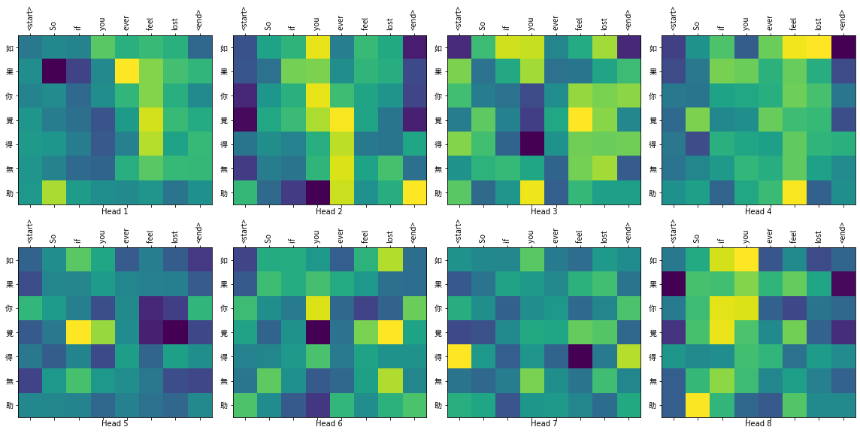
Figure 17: Example of attention mechanism in Transformer

Slide 25
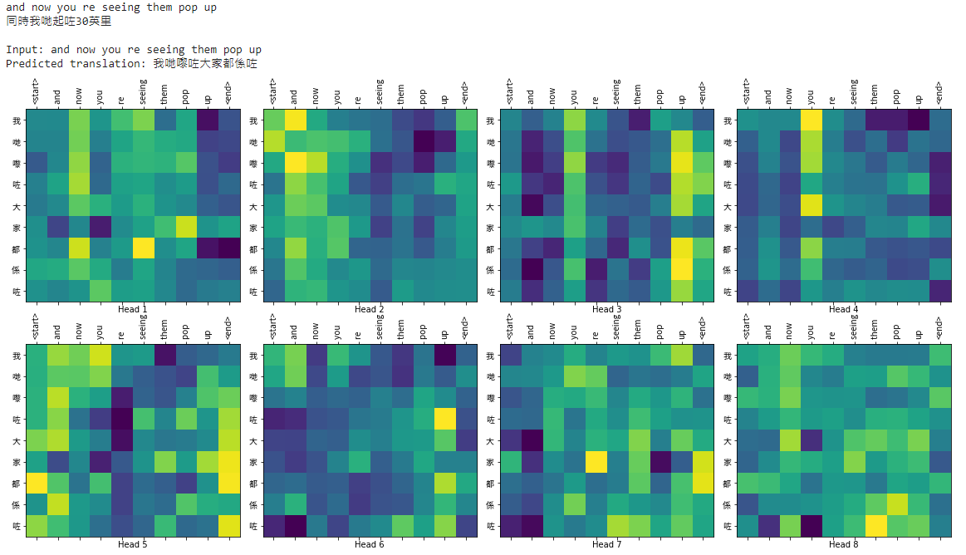
Target output: Different meaning
Figure 18: Example of attention mechanism in Transformer
Actual output: Similar meaning

Slide 26
Evaluation
Accuracy of models and is low
Reliability of models are low
Not functional
Possible explanation
Overfit and underfit (hyperparameter)
Data set is too small (9k vs 100k)
Data set is inaccurate (Not exactly parallel)
These models show inability in Cantonese
Model | Model | Vocab | Character
My model | Eng-Yue Transformer | 2.46 | 3.75
 | Eng-Yue GRU | *1.16 | N/A
Original paper [16] | En-De | 28.4
 | En-Fr | 41.8
Table 1: BLEU scores comparison

Slide 27
Expected result
RBMT
Higher scores
Rules are reliable
Does not depend on large corpus
SMT
Similar result like GRU and Transformer
Rely on large data input

Slide 28

Limitations & recommendations
Data
Heavily based on genre
(movies & talks)
Hard to find Data source
Parallel corpus is hard to achieve
Data preprocessing is troublesome
Recommendation
Improve by manual effort
Find more data source

Slide 29
Limitations & recommendations (Con’d)
Choice of MT models
Some models are outdated
Only famous models are chosen
Cost
Computational power
Time for training MT
Recommendation
Prevent exhaustive training
Limit the finetune process

Slide 30
Future plan
Train & Test & finetune all MT models
January – March
Evaluation + discussion of result
March - April
Provide foundation for future research
End of project

Slide 31
Conclusion
Introduction
Basic Background – Linguistic & computational
Methodology
Data collection – Ted Talks + Netflix
Project status
Current progress – keep on schedule
Results & discussions
Limitations & recommendations – Choice, cost, data
Future plan – train and test + evaluation
Previous studies – PolyUMT99 & LangCompMT05
Aims & objectives
MT examples – RBMT, EBMT, SMT, NMT
Evaluation -- metrics

Slide 32
References
[1] David M. Eberhand, Gary F. Simons, and Charles D. Fenning, editors. Ethnologue: Languages of the World. SIL International, Dallas, TX, twenty-third edition, 2020. https://www.ethnologue.com/.
[2]K. Shah, “Model adaptation techniques in machine translation,” Ph.D. dissertation,Université du Maine, 06 2012.
[3] J. Liu and Y. Yu, “A cantonese­ english machine translation system polyu­mt­99,” inMT SUMMIT VII: MT in the great translation era : proceedings of Machine Trans­lation Summit VII. Kent Ridge Digital Labs, Singapore: Asia­ Pacific Association for Machine Translation, September 2019, pp. 481–486.
[4] Yan Wu, Xiukun Li, and Suen Caesar Lun. A structural-based approach to cantonese-english machine translation. InInternational Journal of Computational Linguistics & Chinese Language Processing, Volume 11, Number 2, June 2006, pages 137–158, 2006
[5] L. Richardson, “Beautiful soup documentation,”April, 2007
[6] R. C. Souza, “raryelcostasouza/pytranscriber v1.4,” Jan. 2020. [Online]. Available:https://github.com/raryelcostasouza/pyTranscriber
[7] M. Forcada, M. Ginestí­Rosell, J. Nordfalk, J. O’Regan, S. Ortiz­Rojas, J. Pérez­Ortiz, F. Sánchez­Martínez, G. Ramírez­Sánchez, and F. Tyers, “Apertium: A free/open­source platform for rule­based machine translation,”Machine Translation, vol. 25, pp. 127–144, 06 2011.
[8] S. Gao, J. Huang, M. Xue, Z. Yu, Z. Wang, and Y. Zhang, “Syntax-based Chinese-Vietnamese tree-to-tree statistical machine translation with bilingual features,” ACM trans. Asian low-resour. lang. inf. process., vol. 18, no. 4, pp. 1–20, 2019.
[9] S. Sato and M. Nagao, “Toward memory-­based translation,” in COLNG 1990 Vol­ume 3: Papers presented to the 13th International Conference on Computational Linguistics, 1990.
[10] R. D. Brown, “The cmu-­ebmt machine translation system,”Machine translation, vol. 25, no. 2, p. 179, 2011.
[11] P. Koehn, H. Hoang, A. Birch, C. Callison, ­Burch, M. Federico, N. Bertoldi,B. Cowan, W. Shen, C. Moran, R. Zenset al., “Moses: Open-source toolkit for sta­tistical machine translation,” in Proceedings of the 45th annual meeting of the ACL on interactive poster and demonstration sessions. Association for Computational Linguistics, 2007, pp. 177–180.
[12] R. Zens, F. J. Och, and H. Ney, “Phrase-­based statistical machine translation,” in Annual Conference on Artificial Intelligence. Springer, 2002, pp. 18–32.
[13] J. Chung, C. Gulcehre, K. Cho, and Y. Bengio, “Empirical evaluation of gated re­current neural networks on sequence modeling,”arXiv preprint arXiv:1412.3555,2014
[14] C. Olah, “Understanding lstm networks,” 2015. [Online]. Available: https://colah.github.io/posts/2015-08-Understanding-LSTMs/
[15] A. Zhang, Z. C. Lipton, M. Li, and A. J. Smola, Dive into Deep Learning, 2020,https://d2l.ai.
[16] A. Vaswani, S. Bengio, E. Brevdo, F. Chollet, A. N. Gomez, S. Gouws, L. Jones,Łukasz Kaiser, N. Kalchbrenner, N. Parmar, R. Sepassi, N. Shazeer, and J. Uszkoreit,“Tensor2tensor for neural machine translation,” 2018.
[17] M. Abadi, P. Barham, J. Chen, Z. Chen, A. Davis, J. Dean, M. Devin, S. Ghemawat,G. Irving, M. Isard, M. Kudlur, J. Levenberg, R. Monga, S. Moore, D. G.Murray, B. Steiner, P. Tucker, V. Vasudevan, P. Warden, M. Wicke, Y. Yu, andX. Zheng, “Tensorflow: A system for large­scale machine learning,” in 12thUSENIX Symposium on Operating Systems Design and Implementation (OSDI 16).
[18] K. Papineni, S. Roukos, T. Ward, and W.­J. Zhu, “Bleu: a method for automatic evaluation of machine translation,” in Proceedings of the 40th annual meeting of the Association for Computational Linguistics, 2002, pp. 311–318.

Slide 33

Thank you!

